Slide 1
Gamer AI
TEAM NAME : Fantastic Four
Murali Krishna Sai Chukka & 05
Venkatesh Ponduri & 23
Apoorva Geetanjali Avadhanula & 01
Hima Bindu Vatsavayi & 28

Slide 2
What is Gamer AI ?

Slide 3
Demo

Slide 4
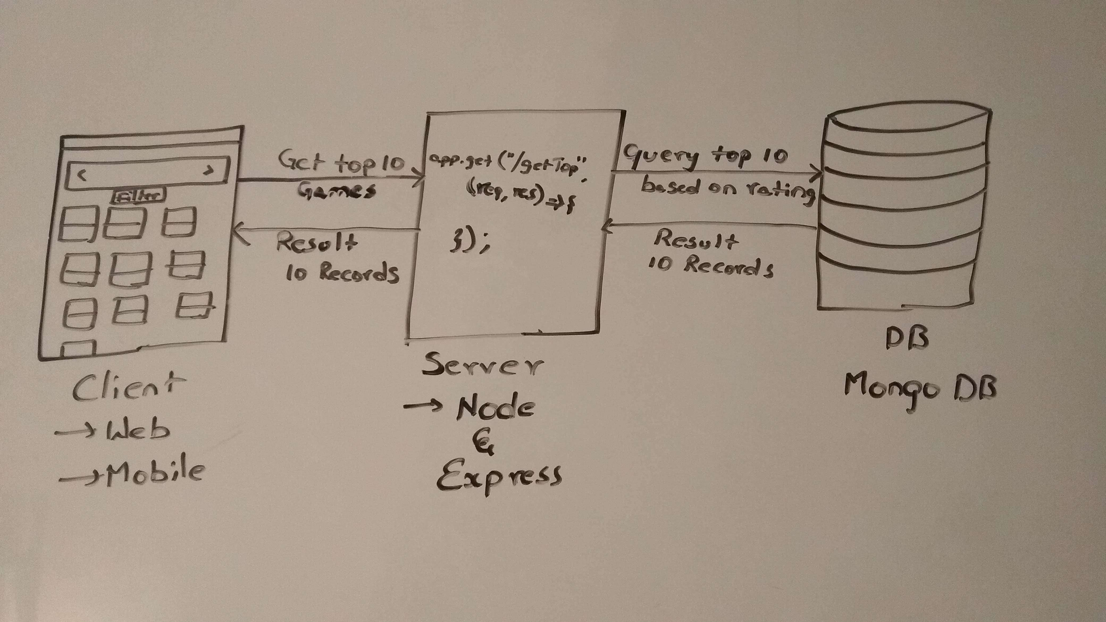
Architecture

Slide 5
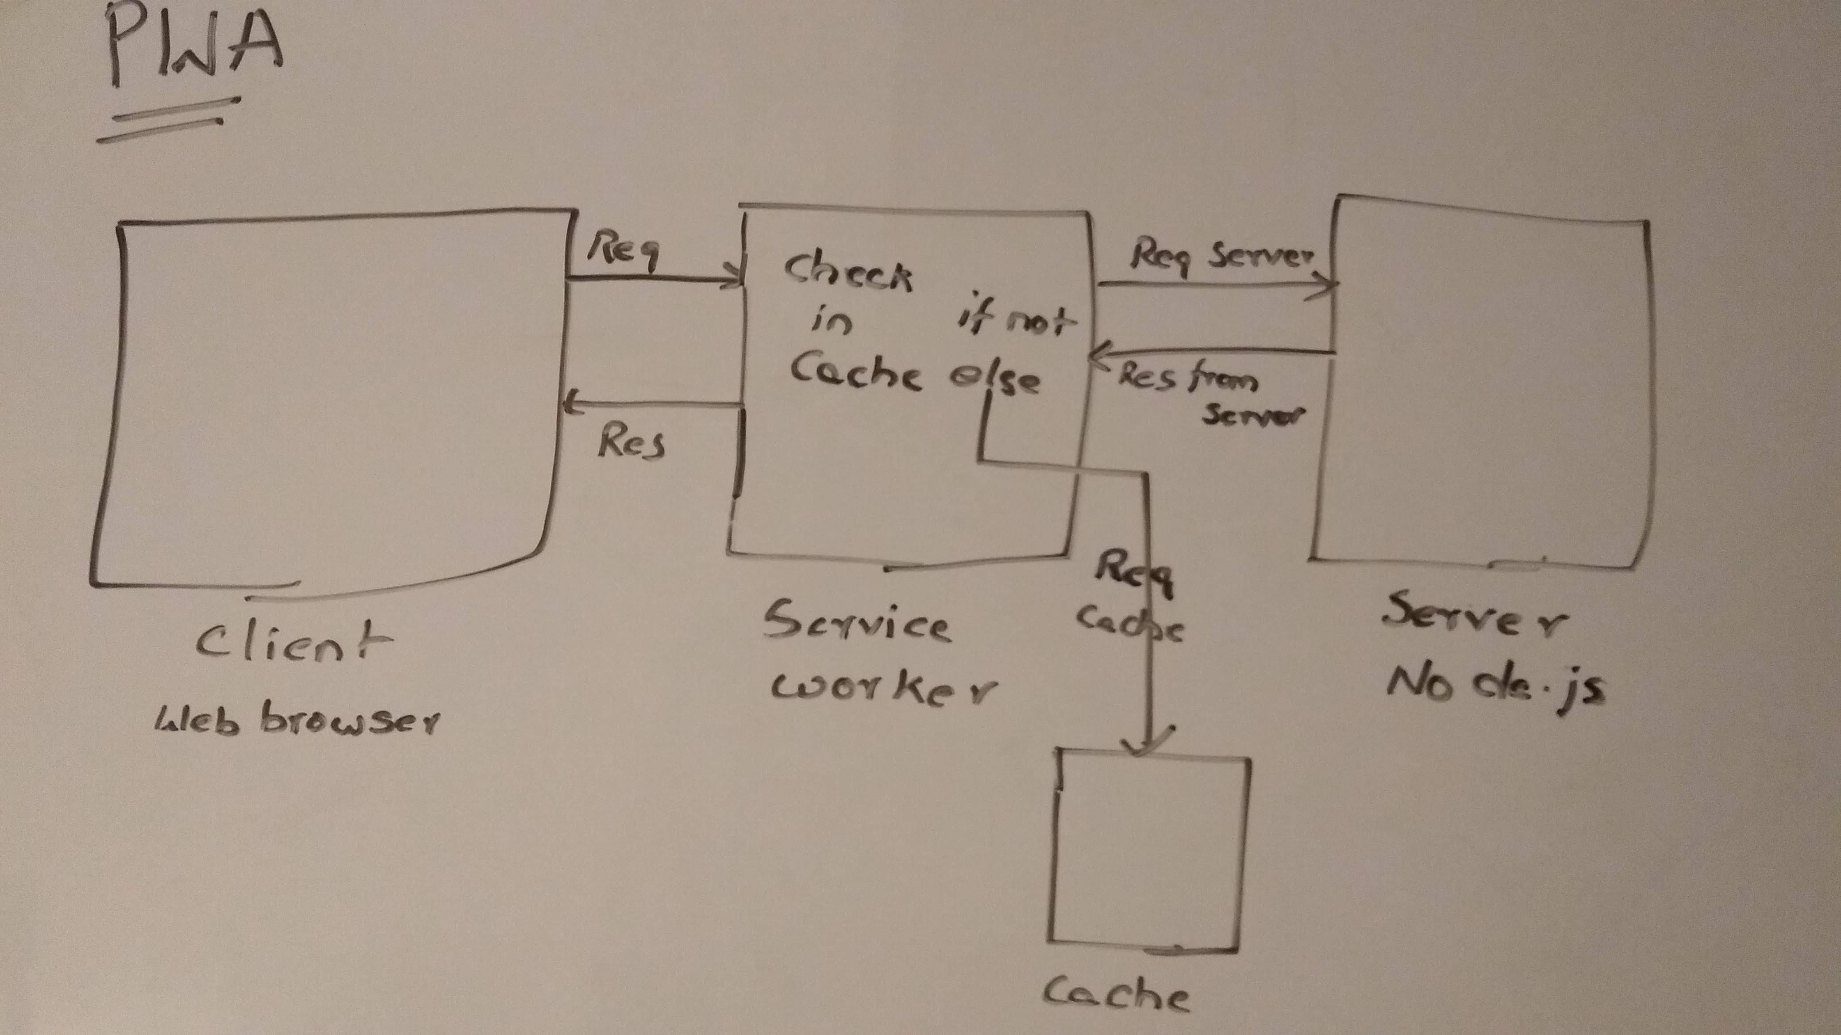
PWA Architecture

Slide 6
Feature enhancements
Creating user account to store his/her collections.
Creating a qrcode for the game.
Implementing complete PWA.

Slide 7
References
https://embed.plnkr.co/plunk/1esaGq (Rating directive)
https://www.youtube.com/watch?v=gcx-3qi7t7c&t=1064s (PWA)

Slide 8
Thank You

